Slide 1
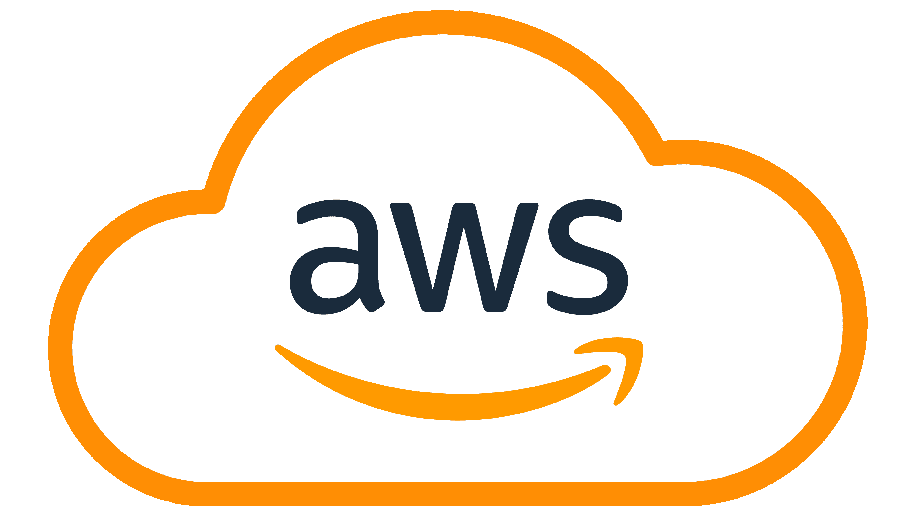
AMAZON WEB SERVICES
AWS Cloud Foundations
Mohanraj M (Cloud Architect, AWS Certified Educator, AWS Certified Solutions Architect - Associate )

Slide 2
LEARNING PATH
Contents
01
What is Cloud Computing?
02
Benefits of Cloud Adoption
Understanding the fundamentals, NIST definition, and five essential characteristics that define cloud computing technology
Key benefits driving cloud adoption and the economic transformation from CapEx to OpEx models
03
Core Cloud Terminology
04
AWS Global Infrastructure
Service models (IaaS, PaaS, SaaS) and deployment models (Public, Private, Hybrid, Community)
Regions, Availability Zones, Edge Locations, and core AWS services that power cloud applications
05
AWS Cloud Labs
Well-Architected Framework, and your path to becoming AWS certified

Slide 3
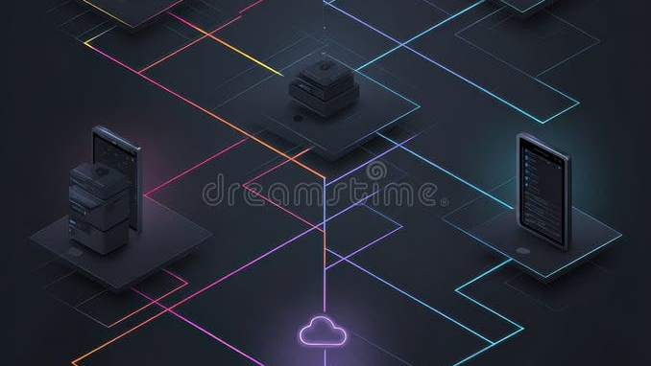
01
What is Cloud
Computing?
Understanding the fundamentals of cloud computing technology and its defining characteristics

Slide 4
CHAPTER 01 • CLOUD FUNDAMENTALS
Cloud Computing Defined
NIST Official Definition
Cloud computing is a model for enabling on-demand network access to a shared pool of configurable computing resources (e.g., networks, servers, storage, applications, and services) that can be rapidly provisioned and released with minimal management effort or service provider interaction.
No Physical Infrastructure
Dynamic Provisioning
Network Accessibility
Organizations no longer need to purchase, own, and maintain physical servers, data centers, or networking equipment. The cloud provider manages all underlying hardware.
Resources can be provisioned and released automatically through APIs or web interfaces, enabling true on-demand scalability without human intervention from the provider.
Cloud services are accessed over the internet using standard protocols, enabling users to work from anywhere with any internet-connected device—laptops, tablets, or smartphones.
Service Models
Deployment Models
Core Components
IaaS, PaaS, SaaS
Public, Private, Hybrid, Community
5 Essential Characteristics

Slide 5
CHAPTER 01 • CLOUD FUNDAMENTALS
Five Essential Characteristics
The NIST-defined characteristics that distinguish true cloud computing from traditional IT
On-Demand Self-Service
Broad Network Access
Automatic Provisioning
Universal Accessibility
A consumer can unilaterally provision computing capabilities such as server time and network storage as needed automatically without requiring human interaction with each service provider.
Capabilities are available over the network and accessed through standard mechanisms that promote use by heterogeneous thin or thick client platforms (e.g., mobile phones, tablets, laptops, and workstations).
Example: Launching an EC2 instance through the AWS Console without contacting AWS support
Example: Accessing S3 buckets from any device with internet connectivity via web browser or API
Resource Pooling
Rapid Elasticity
Multi-Tenancy Model
Instant Scaling
The provider's computing resources are pooled to serve multiple consumers using a multi-tenant model, with different physical and virtual resources dynamically assigned and reassigned according to consumer demand.
Capabilities can be elastically provisioned and released, in some cases automatically, to scale rapidly outward and inward commensurate with demand. To the consumer, the capabilities available often appear to be unlimited.
Example: Multiple customers share the same physical server hardware while maintaining complete isolation
Example: Auto Scaling groups automatically adding EC2 instances during traffic spikes
Measured Service
Cloud systems automatically control and optimize resource use by leveraging a metering capability at some level of abstraction appropriate to the type of service. Resource usage can be monitored, controlled, and reported, providing transparency for both the provider and consumer.
Example: AWS Cost Explorer showing detailed usage and billing for each service

Slide 6

02
Benefits of
Cloud Adoption
Why organizations worldwide are accelerating their cloud transformation journey

Slide 7
CHAPTER 02 • CLOUD ADVANTAGES
Key Benefits of Cloud Computing
Six transformative advantages driving enterprise cloud adoption
Scalability
Cost Efficiency
Global Reach
Easily scale resources up or down based on demand. Handle traffic spikes without over-provisioning during quiet periods. Scale vertically (more power per instance) or horizontally (more instances).
Pay-as-you-go pricing eliminates upfront capital expenditure. Convert fixed costs to variable costs. No need to purchase excess capacity for peak periods—pay only for what you consume.
Deploy applications worldwide in minutes across multiple regions. Serve users from edge locations closest to them, reducing latency to single-digit milliseconds. AWS operates in 38 geographic regions.
Impact: Netflix scales to handle millions of concurrent viewers during peak hours
Impact: Startups can launch with minimal investment and scale as they grow
Impact: Global businesses provide consistent performance across continents
High Availability
Agility
Elasticity
Built-in redundancy across multiple data centers (Availability Zones). Automatic failover ensures applications remain operational even during infrastructure failures. AWS guarantees 99.99% uptime for many services.
Rapidly experiment and innovate without lengthy procurement cycles. Provision resources in minutes instead of weeks. Test new ideas quickly and fail fast at minimal cost.
Automatic scaling to match workload fluctuations in real-time. Resources scale out during demand spikes and scale in during quiet periods without manual intervention. Optimize performance and cost simultaneously.
Impact: Mission-critical applications maintain continuous operation 24/7/365
Impact: Product teams iterate faster and bring innovations to market quicker
Impact: E-commerce sites handle Black Friday traffic without manual intervention

Slide 8
CHAPTER 02 • CLOUD ADVANTAGES
Cloud Economics: CapEx vs OpEx
Understanding the fundamental economic shift from capital to operational expenditure
Traditional On-Premises
Cloud Computing
Capital Expenditure (CapEx) Model
Operational Expenditure (OpEx) Model
Upfront Hardware Investment
Pay-as-You-Go Pricing
Purchase servers, storage, networking equipment—often $100K+ initial investment
Pay only for resources consumed, billed by the second or hour with no upfront costs
Data Center Costs
No Infrastructure Management
Facility space, power, cooling, physical security, and maintenance staff
Provider manages all hardware, facilities, and maintenance—zero operational overhead
Over-Provisioning
Must buy capacity for peak usage, leaving resources idle 70-80% of the time
Right-Sizing & Auto-Scaling
Depreciation & Obsolescence
Match resources exactly to demand. Scale automatically without waste
Hardware depreciates over 3-5 years and becomes technologically obsolete
Always Current Technology
Long Procurement Cycles
Access latest hardware and software innovations without upgrade costs
Weeks or months to order, receive, and deploy new hardware
Instant Provisioning
Deploy resources in minutes through APIs or web interfaces
Typical Cost Structure: 70% CapEx (upfront) + 30% OpEx (ongoing)
Typical Cost Structure: 0% CapEx + 100% OpEx (utility model)
Key Insight: Cloud computing transforms IT from a capital-intensive cost center to a flexible operational expense that scales with business value
Average Savings
31%

Slide 9
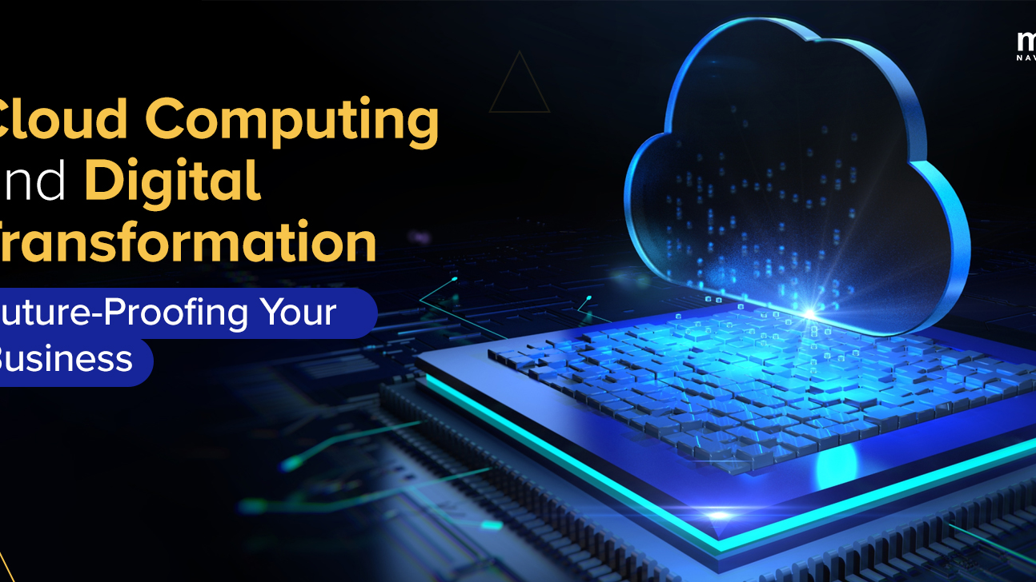
03
Core Cloud
Terminology
Understanding service models and deployment models that define cloud architecture

Slide 10
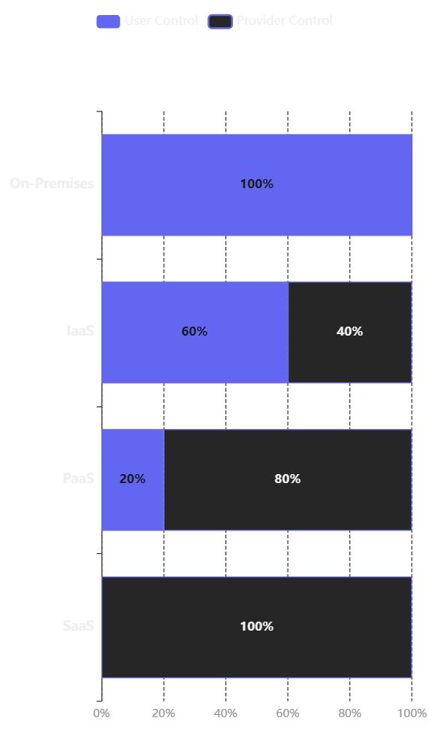
CHAPTER 03 • CLOUD TERMINOLOGY
Cloud Service Models: IaaS, PaaS, SaaS
Three fundamental models defining how cloud services are delivered and consumed
Service Model Comparison
IaaS
Infrastructure as a Service
Provides virtualized computing resources—servers, storage, and networking—over the internet. Users rent cloud infrastructure but manage their own operating systems, applications, and data.
User Manages
Provider Manages
OS, Middleware, Runtime, Applications, Data
Virtualization, Servers, Storage, Networking
AWS EC2
Azure VMs
GCE
PaaS
Platform as a Service
Offers a complete development platform in the cloud including operating systems, databases, and tools. Developers can build, test, and deploy applications without managing underlying infrastructure.
User Manages
Provider Manages
Applications, Data
Runtime, Middleware, OS, Virtualization, Infrastructure
AWS Elastic Beanstalk
Heroku
App Engine
SaaS
Software as a Service
Delivers fully managed software applications over the internet. Users simply log in through a browser, eliminating the need for installation, maintenance, or management.
User Manages
Provider Manages
Nothing—just use the application
Everything: Application, Data, Runtime, Middleware, OS, Infrastructure
Microsoft 365
Zoom
Salesforce

Slide 11
CHAPTER 03 • CLOUD TERMINOLOGY
Cloud Deployment Models
Four approaches to deploying cloud infrastructure based on organizational needs
Public Cloud
Private Cloud
Shared Infrastructure
Dedicated Infrastructure
Infrastructure is owned and operated by third-party providers (AWS, Azure, GCP) and resources are shared across multiple tenants. Ideal for general-purpose workloads requiring high scalability.
Infrastructure is dedicated to a single organization, either on-premises or hosted externally. Provides maximum control, security, and customization for compliance-heavy environments.
Pros: High scalability, pay-as-you-go, no maintenance
Pros: Full control, strong security, custom compliance
Cons: Limited control, security concerns for sensitive data
Cons: Higher cost, requires IT expertise, limited scalability
Best For: Startups, web apps, dev/test environments, variable workloads
Best For: Banks, healthcare, government, regulated industries
Hybrid Cloud
Community Cloud
Best of Both Worlds
Shared by Organizations
Combines public and private clouds, enabling data and application portability between environments. Organizations can keep sensitive data private while leveraging public cloud scalability.
Infrastructure is shared by several organizations with common concerns (security, compliance, mission). Costs are distributed among community members while maintaining data isolation.
Pros: Flexibility, cost optimization, disaster recovery
Pros: Cost sharing, collaborative focus, targeted compliance
Cons: Complex integration, management overhead
Cons: Limited scalability, shared governance decisions
Best For: Enterprises migrating to cloud, seasonal workloads
Best For: Government agencies, healthcare consortiums, research institutions

Slide 12

04
AWS Global
Infrastructure
Understanding how AWS delivers cloud services worldwide with high availability and low latency

Slide 13
CHAPTER 04 • AWS INFRASTRUCTURE
AWS Global Infrastructure Components
The foundation of AWS cloud services: Regions, Availability Zones, and Edge Locations
Regions
Edge Locations
Geographic Locations
Content Delivery Network
A Region is a physical location in the world where AWS has multiple Availability Zones. Each Region is completely independent and isolated from other Regions for fault tolerance and stability.
A globally distributed network of data centers that cache content close to end users. Edge Locations deliver content with ultra-low latency and high throughput using Amazon's high-speed network.
400+
<10ms
38
120
Edge Locations
Response Time
Geographic Regions
Availability Zones
Services Using Edge Locations:
Examples: us-east-1 (N. Virginia), eu-west-1 (Ireland), ap-southeast-1 (Singapore)
CloudFront (CDN)
Route 53 (DNS)
Global Accelerator
Lambda@Edge
Availability Zones
Regional Edge Caches
Isolated Data Centers
Intermediate Caching Layer
An AZ is one or more discrete data centers with redundant power, networking, and connectivity in an AWS Region. AZs are physically separate (miles apart) to prevent correlated failures.
Sit between Edge Locations and origin servers in the CloudFront CDN. They cache larger or less frequently accessed objects that may not be stored at every Edge Location, improving cache hit ratios and reducing origin load.
Independent Infrastructure: Each AZ has its own power, cooling, and networking
Low-Latency Connections: AZs in a Region are connected via high-speed private networks
Larger Cache Capacity: Hold content that doesn't fit in standard Edge Locations
High Availability: Deploy across multiple AZs for fault tolerance
Reduced Origin Load: Decrease requests back to origin servers
Key Principle: AWS designs for failure—deploy applications across multiple Availability Zones for high availability and fault tolerance
AWS Global Footprint
190+ Countries

Slide 14
CHAPTER 04 • AWS INFRASTRUCTURE
AWS Core Services Overview
Foundational services that power cloud applications on AWS
Amazon EC2
Amazon S3
Elastic Compute Cloud
Simple Storage Service
Provides resizable virtual servers in the cloud. Launch instances with various operating systems, configure security and networking, and manage storage. Choose from hundreds of instance types optimized for different workloads.
Offers industry-leading scalability, data availability, security, and performance. Store and retrieve any amount of data from anywhere. Designed for 99.999999999% (11 nines) durability.
Instance Types: General purpose, compute-optimized, memory-optimized, GPU instances
Storage Classes: Standard, Intelligent-Tiering, Glacier, Deep Archive
Pricing Models: On-Demand, Reserved, Spot, Savings Plans
Features: Versioning, lifecycle policies, cross-region replication
Auto Scaling: Automatically adjust capacity based on demand
Security: Encryption at rest and in transit, access policies
Use Cases: Web hosting, batch processing, machine learning, gaming servers
Use Cases: Data lakes, backups, static website hosting, content distribution
Amazon RDS
AWS Lambda
Relational Database Service
Serverless Compute
Makes it easy to set up, operate, and scale relational databases in the cloud. Automates time-consuming administration tasks such as hardware provisioning, database setup, patching, and backups.
Lets you run code without provisioning or managing servers. Automatically scales from a few requests per day to thousands per second. Pay only for the compute time you consume—no charge when code is not running.
Supported Engines: MySQL, PostgreSQL, MariaDB, Oracle, SQL Server
Event-Driven: Trigger from S3, DynamoDB, API Gateway, CloudWatch
High Availability: Multi-AZ deployments with automatic failover
Supported Languages: Python, Node.js, Java, Go, C#, Ruby
Read Replicas: Scale read-heavy workloads horizontally
Subsecond Billing: Pay per request and execution time (100ms increments)
Use Cases: E-commerce transactions, CRM systems, financial applications
Use Cases: Real-time file processing, data transformation, API backends, automation

Slide 15
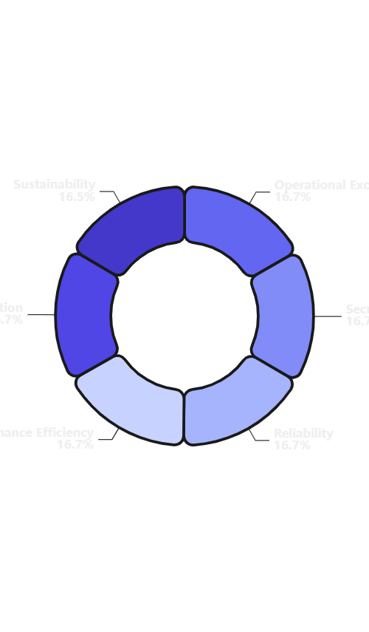
CHAPTER 05 • CERTIFICATION
AWS Well-Architected Framework
Six pillars guiding cloud architecture decisions for optimal outcomes
Pillar Distribution
Operational Excellence
Security
Run and monitor systems to deliver business value and continually improve supporting processes and procedures. Focus on automation, observability, and iterative improvement.
Protect information, systems, and assets while delivering business value through risk assessments and mitigation strategies. Implement defense in depth, least privilege, and encryption.
Reliability
Performance Efficiency
Ensure workloads perform their intended functions correctly and consistently, and recover quickly from failures. Design for fault tolerance, automated recovery, and horizontal scaling.
Use IT and computing resources efficiently to meet system requirements and maintain efficiency as demand changes. Right-size resources, use serverless, and leverage caching.
Cost Optimization
Sustainability
The Well-Architected Framework provides a consistent approach to evaluate architectures and implement designs that scale over time
Run systems to deliver business value at the lowest price point. Implement right-sizing, Reserved Instances, Spot Instances, and continuous cost monitoring.
Minimize the environmental impact of running cloud workloads. Understand impact, establish sustainability goals, maximize utilization, and adopt efficient hardware.

